Slide 1
Entity-Relationship Model

Slide 2
Entity-Relationship Model
Design Process
Modeling
Constraints
E-R Diagram
Design Issues
Weak Entity Sets
Extended E-R Features
Design of the Bank Database
Reduction to Relation Schemas
Database Design
UML

Slide 3
E-R Modeling
A database can be modeled as:
  a collection of entities,
  relationship among entities.
An entity is an object that exists and is distinguishable from other objects.
  Example: specific person, company, event, plant
Entities have attributes
  Example: people have names and addresses
An entity set is a set of entities of the same type that share the same properties.
  Example: set of all persons, companies, trees, holidays

Slide 4
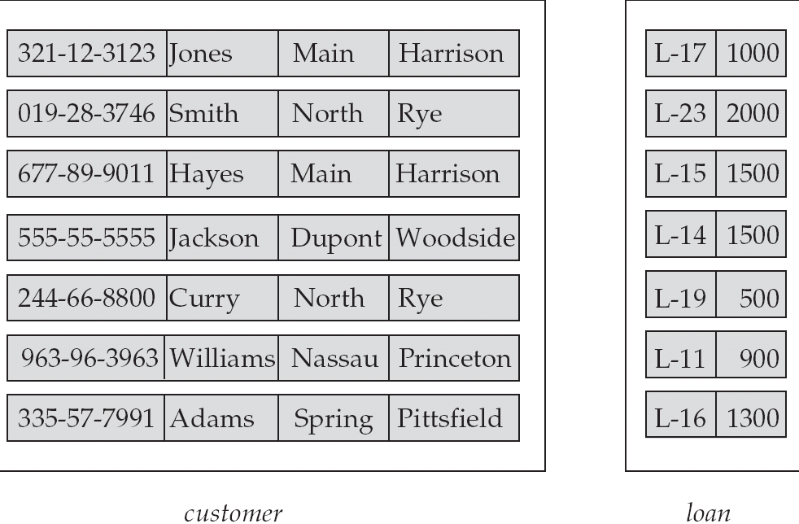
Entity Sets customer and loan
customer_id customer_ customer_ customer_ loan_ amount
name street city number

Slide 5
Relationship Sets
A relationship is an association among several entities
Example:
Hayes depositor A-102
customer entity relationship set account entity
A relationship set is a mathematical relation among n ≥ 2 entities, each taken from entity sets
{(e₁, e₂, … e_{n}) | e₁ ∈ E₁, e₂ ∈ E₂, …, e_{n} ∈ E_{n}}
where (e₁, e₂, …, e_{n}) is a relationship
  Example:
  (Hayes, A-102) ∈ depositor

Slide 6
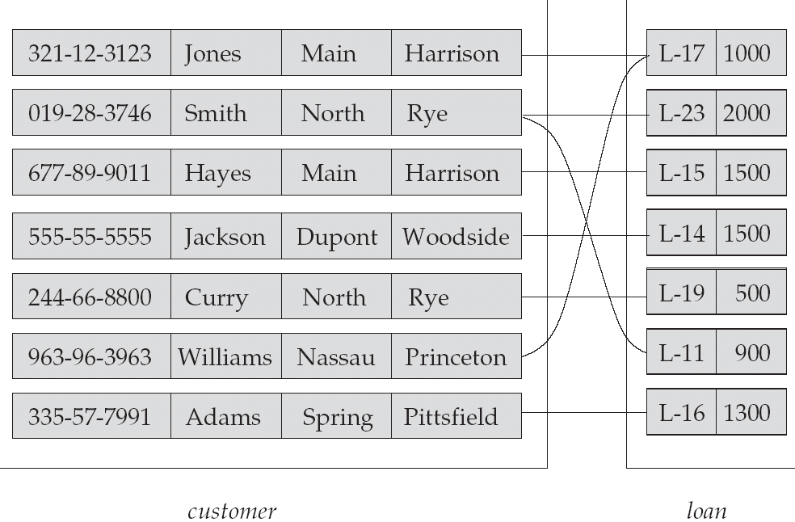
Relationship Set borrower

Slide 7
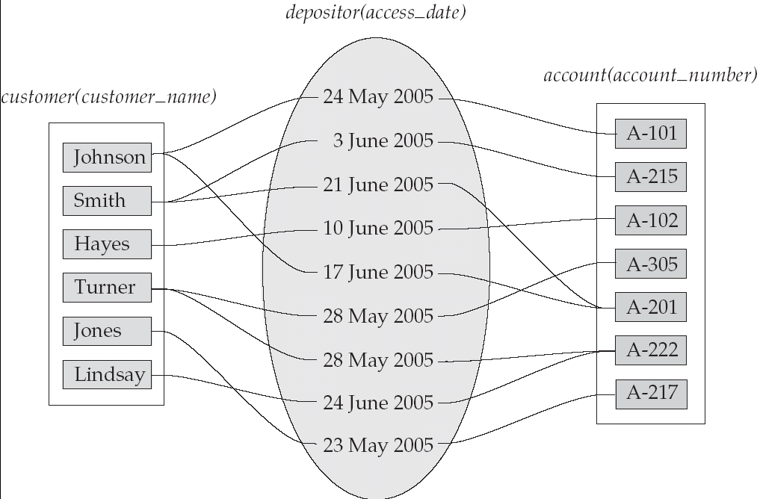
Relationship Sets (Cont.)
An attribute can also be property of a relationship set.
For instance, the depositor relationship set between entity sets customer and account may have the attribute access-date

Slide 8
Degree of a Relationship Set
Refers to number of entity sets that participate in a relationship set.
Relationship sets that involve two entity sets are binary (or degree two). Generally, most relationship sets in a database system are binary.
Relationship sets may involve more than two entity sets.
Relationships between more than two entity sets are rare. Most relationships are binary. (More on this later.)
  Example: Suppose employees of a bank may have jobs (responsibilities) at multiple branches, with different jobs at different branches. Then there is a ternary relationship set between entity sets employee, job, and branch

Slide 9
Attributes
An entity is represented by a set of attributes, that is descriptive properties possessed by all members of an entity set.
Domain – the set of permitted values for each attribute
Attribute types:
  Simple and composite attributes.
  Single-valued and multi-valued attributes
    Example: multivalued attribute: phone_numbers
  Derived attributes
    Can be computed from other attributes
    Example: age, given date_of_birth
Example:
customer = (customer_id, customer_name, customer_street, customer_city )
loan = (loan_number, amount )

Slide 10
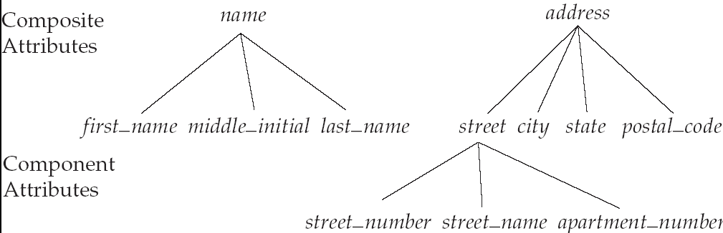
Composite Attributes

Slide 11
Mapping Cardinality Constraints
Express the number of entities to which another entity can be associated via a relationship set.
Most useful in describing binary relationship sets.
For a binary relationship set the mapping cardinality must be one of the following types:
  One to one
  One to many
  Many to one
  Many to many

Slide 12
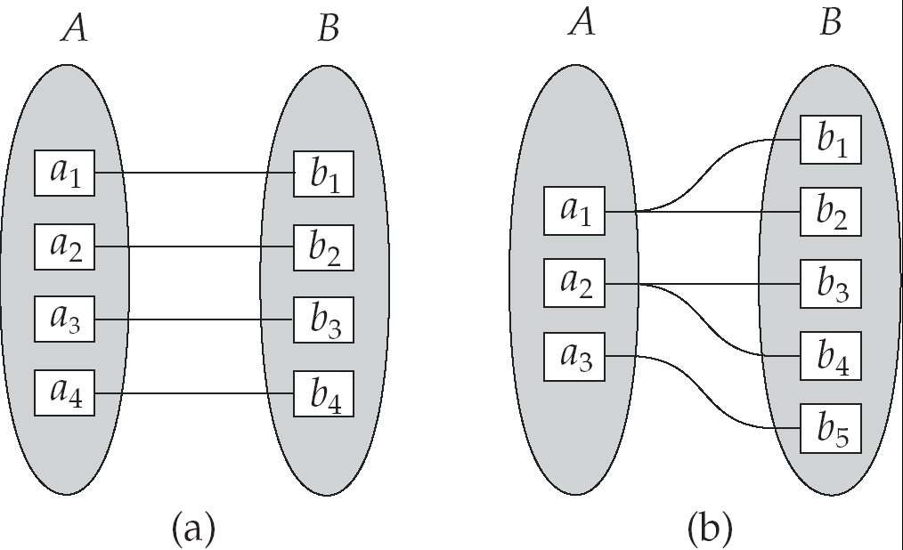
Mapping Cardinalities
One to one
One to many
Note: Some elements in A and B may not be mapped to any
elements in the other set

Slide 13
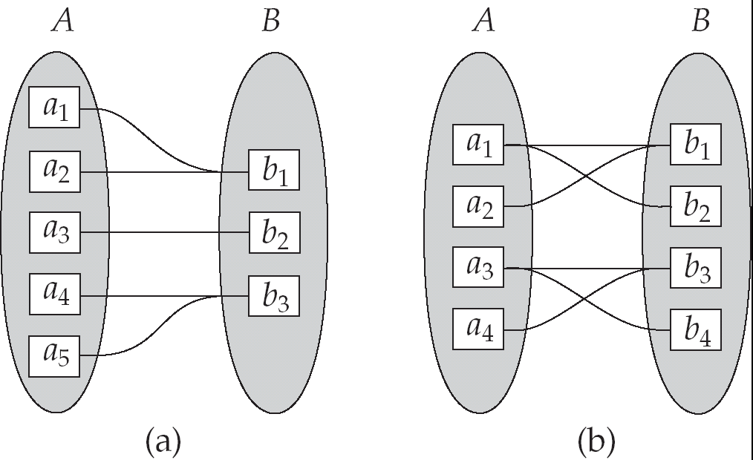
Mapping Cardinalities
Many to one
Many to many
Note: Some elements in A and B may not be mapped to any
elements in the other set

Slide 14
Keys
A super key of an entity set is a set of one or more attributes whose values uniquely determine each entity.
A candidate key of an entity set is a minimal super key
  Customer_id is candidate key of customer
  account_number is candidate key of account
Although several candidate keys may exist, one of the candidate keys is selected to be the primary key.

Slide 15
Keys for Relationship Sets
The combination of primary keys of the participating entity sets forms a super key of a relationship set.
  (customer_id, account_number) is the super key of depositor
  NOTE: this means a pair of entity sets can have at most one relationship in a particular relationship set.
    Example: if we wish to track all access_dates to each account by each customer, we cannot assume a relationship for each access. We can use a multivalued attribute though
Must consider the mapping cardinality of the relationship set when deciding what are the candidate keys
Need to consider semantics of relationship set in selecting the primary key in case of more than one candidate key

Slide 16
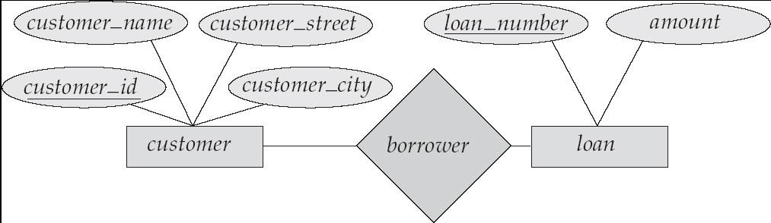
E-R Diagrams
Rectangles represent entity sets.
Diamonds represent relationship sets.
Lines link attributes to entity sets and entity sets to relationship sets.
Ellipses represent attributes
  Double ellipses represent multivalued attributes.
  Dashed ellipses denote derived attributes.
Underline indicates primary key attributes (will study later)

Slide 17
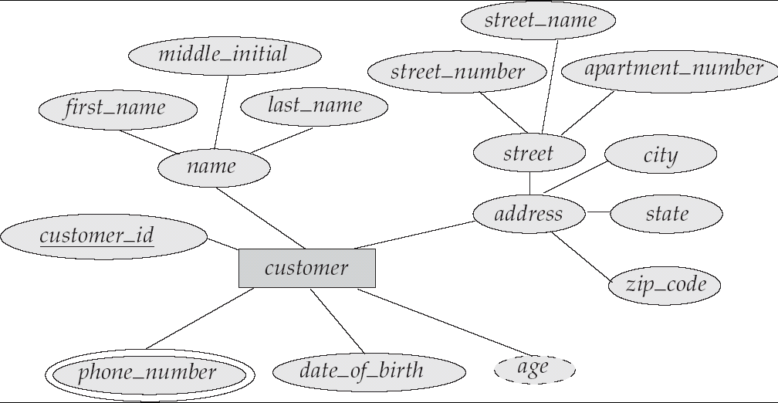
E-R Diagram With Composite, Multivalued, and Derived Attributes

Slide 18
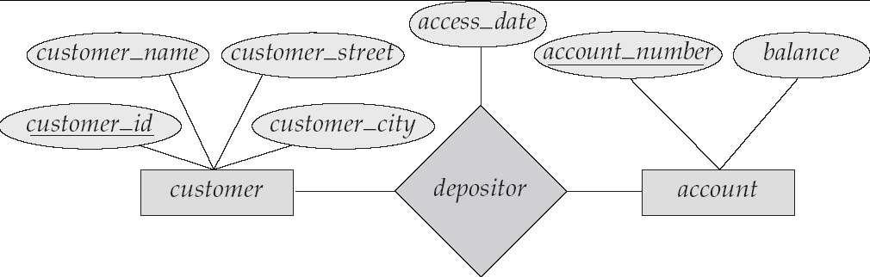
Relationship Sets with Attributes

Slide 19
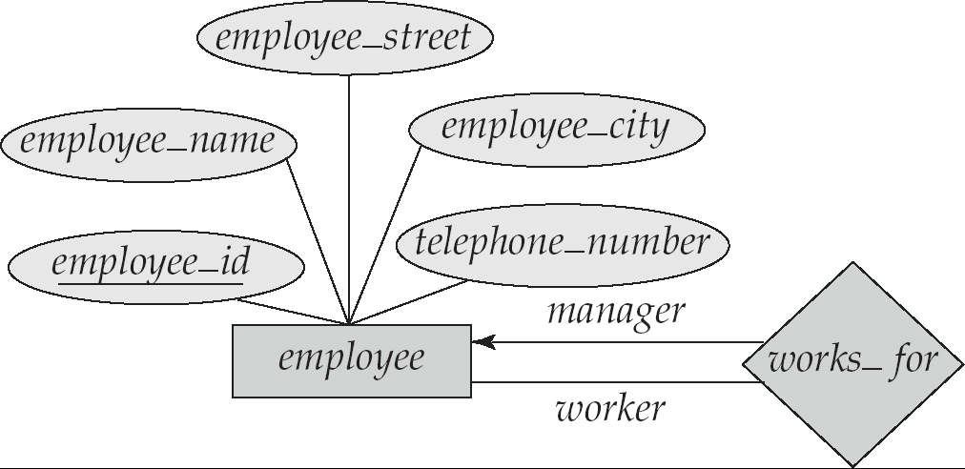
Roles
Entity sets of a relationship need not be distinct
The labels “manager” and “worker” are called roles; they specify how employee entities interact via the works_for relationship set.
Roles are indicated in E-R diagrams by labeling the lines that connect diamonds to rectangles.
Role labels are optional, and are used to clarify semantics of the relationship

Slide 20
Cardinality Constraints
We express cardinality constraints by drawing either a directed line (→), signifying “one,” or an undirected line (—), signifying “many,” between the relationship set and the entity set.
One-to-one relationship:
  A customer is associated with at most one loan via the relationship borrower
  A loan is associated with at most one customer via borrower

Slide 21

One-To-Many Relationship
In the one-to-many relationship a loan is associated with at most one customer via borrower, a customer is associated with several (including 0) loans via borrower

Slide 22
Many-To-One Relationships
In a many-to-one relationship a loan is associated with several (including 0) customers via borrower, a customer is associated with at most one loan via borrower

Slide 23

Many-To-Many Relationship
A customer is associated with several (possibly 0) loans via borrower
A loan is associated with several (possibly 0) customers via borrower

Slide 24
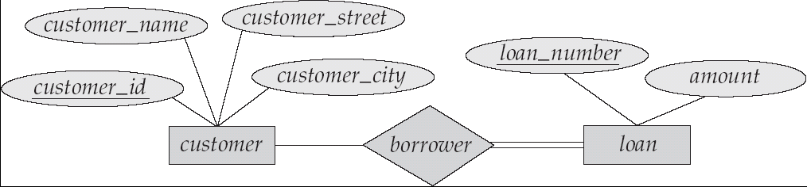
Participation of an Entity Set in a Relationship Set
Total participation (indicated by double line): every entity in the entity set participates in at least one relationship in the relationship set
  E.g. participation of loan in borrower is total
    every loan must have a customer associated to it via borrower
Partial participation: some entities may not participate in any relationship in the relationship set
  Example: participation of customer in borrower is partial

Slide 25
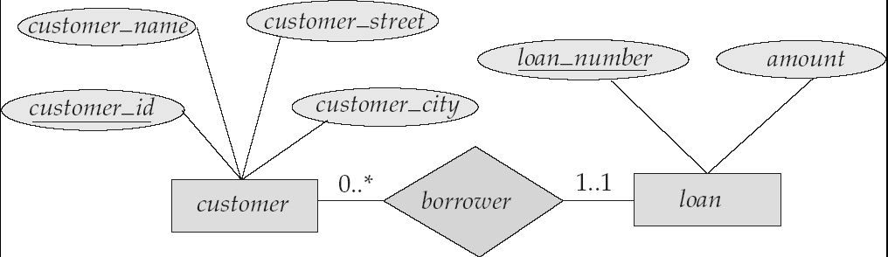
Alternative Notation for Cardinality Limits
Cardinality limits can also express participation constraints

Slide 26
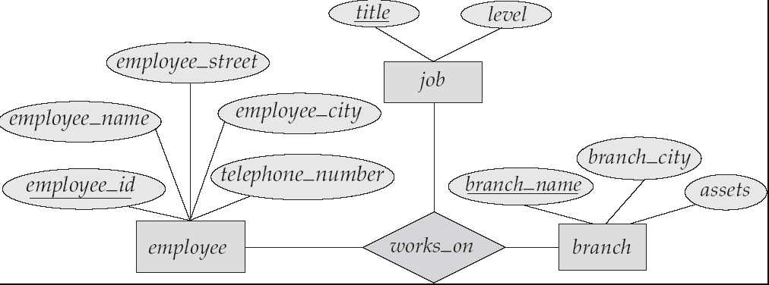
E-R Diagram with a Ternary Relationship

Slide 27
Example COMPANY Database
Requirements of the Company (oversimplified for illustrative purposes)
  The company is organized into DEPARTMENTs. Each department has a name, number and an employee who manages the department. We keep track of the start date of the department manager.
  Each department controls a number of PROJECTs. Each project has a name, number and is located at a single location.

Slide 28
Example COMPANY Database (Cont.)
  We store each EMPLOYEE’s social security number, address, salary, sex, and birthdate. Each employee works for one department but may work on several projects. We keep track of the number of hours per week that an employee currently works on each project. We also keep track of the direct supervisor of each employee.
  Each employee may have a number of DEPENDENTs. For each dependent, we keep track of their name, sex, birthdate, and relationship to employee.

Slide 29
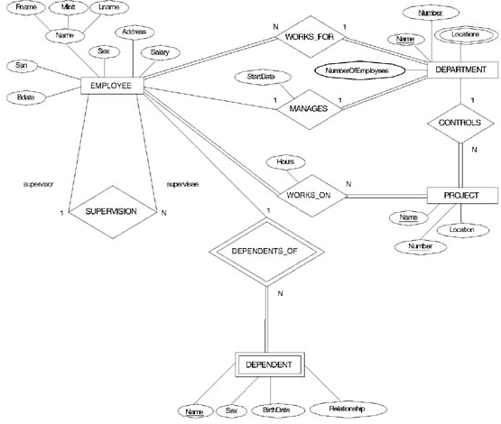
ER DIAGRAM – Entity Types are:
EMPLOYEE, DEPARTMENT, PROJECT, DEPENDENT

Slide 30
Weak Entity Sets
An entity set that does not have a primary key is referred to as a weak entity set.
The existence of a weak entity set depends on the existence of a identifying entity set
  it must relate to the identifying entity set via a total, one-to-many relationship set from the identifying to the weak entity set
  Identifying relationship depicted using a double diamond
The discriminator (or partial key) of a weak entity set is the set of attributes that distinguishes among all the entities of a weak entity set.
The primary key of a weak entity set is formed by the primary key of the strong entity set on which the weak entity set is existence dependent, plus the weak entity set’s discriminator.
Example:
Suppose that a DEPENDENT entity is identified by the dependent’s first name and birhtdate, and the specific EMPLOYEE that the dependent is related to. DEPENDENT is a weak entity type with EMPLOYEE as its identifying entity type via the identifying relationship type DEPENDENT_OF

Slide 31
Weak Entity Type is: DEPENDENT
Identifying Relationship is: DEPENDENTS_OF
Chapter 3-<number>

Slide 32
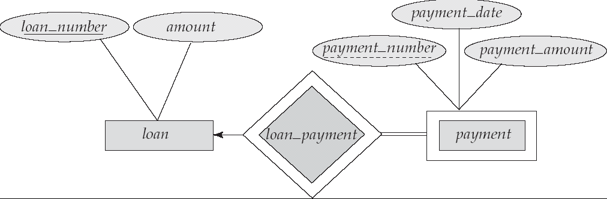
Weak Entity Sets (Cont.)
We depict a weak entity set by double rectangles.
We underline the discriminator of a weak entity set with a dashed line.
payment_number – discriminator of the payment entity set
Primary key for payment – (loan_number, payment_number)

Slide 33
Weak Entity Sets (Cont.)
Note: the primary key of the strong entity set is not explicitly stored with the weak entity set, since it is implicit in the identifying relationship.
If loan_number were explicitly stored, payment could be made a strong entity, but then the relationship between payment and loan would be duplicated by an implicit relationship defined by the attribute loan_number common to payment and loan

Slide 34
More Weak Entity Set Examples
In a university, a course is a strong entity and a course_offering can be modeled as a weak entity
The discriminator of course_offering would be semester (including year) and section_number (if there is more than one section)
If we model course_offering as a strong entity we would model course_number as an attribute.
Then the relationship with course would be implicit in the course_number attribute

Slide 35
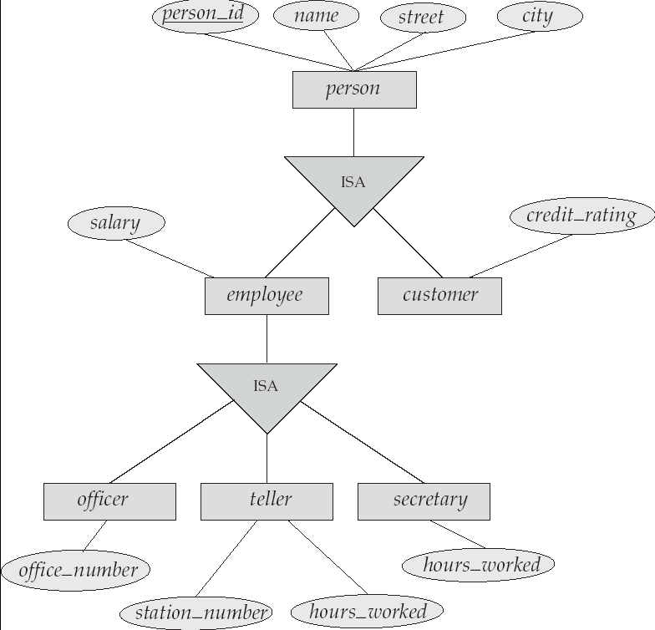
Specialization Example

Slide 36
Extended ER Features: Generalization
A bottom-up design process – combine a number of entity sets that share the same features into a higher-level entity set.
Specialization and generalization are simple inversions of each other; they are represented in an E-R diagram in the same way.
The terms specialization and generalization are used interchangeably.

Slide 37
Specialization and Generalization (Cont.)
Can have multiple specializations of an entity set based on different features.
E.g. permanent_employee vs. temporary_employee, in addition to officer vs. secretary vs. teller
Each particular employee would be
  a member of one of permanent_employee or temporary_employee,
  and also a member of one of officer, secretary, or teller
The ISA relationship also referred to as superclass - subclass relationship

Slide 38
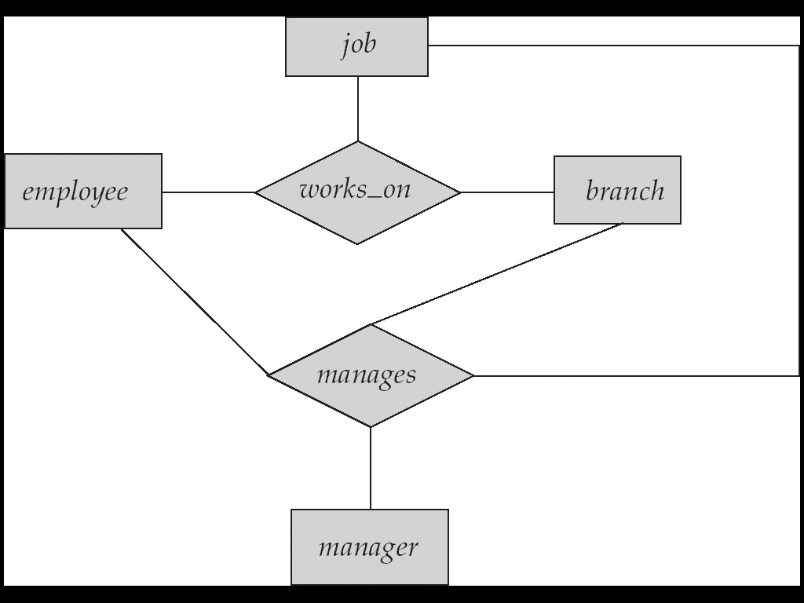
Aggregation
Consider the ternary relationship works_on, which we saw earlier
Suppose we want to record managers for tasks performed by an
employee at a branch

Slide 39
Aggregation (Cont.)
Relationship sets works_on and manages represent overlapping information
  Every manages relationship corresponds to a works_on relationship
  However, some works_on relationships may not correspond to any manages relationships
    So we can’t discard the works_on relationship
Eliminate this redundancy via aggregation
  Treat relationship as an abstract entity
  Allows relationships between relationships
  Abstraction of relationship into new entity
Without introducing redundancy, the following diagram represents:
  An employee works on a particular job at a particular branch
  An employee, branch, job combination may have an associated manager

Slide 40
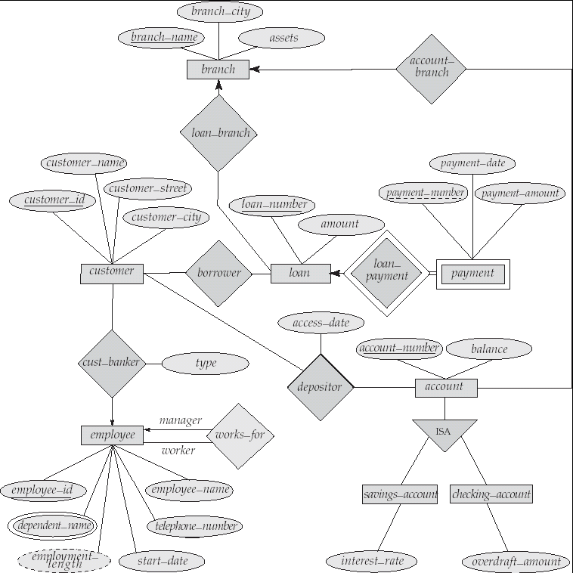
E-R Diagram for a Banking Enterprise

